Slide 1

Project Title - Netflix Dataset Analysis
[Kunsh Mittal]
[STU681c3f24e17fd1746681636]

Slide 2

PROBLEM STATEMENT
Netflix has become one of the most prominent global streaming platforms, continuously expanding its library with a mix of original productions and licensed content. However, with growing competition from platforms like Amazon Prime, Disney+, and regional OTT providers, Netflix must strategically analyze its content catalog to identify strengths, gaps, and opportunities.

Slide 3
Project Description
Data Loading & Initial Exploration: The dataset was loaded using Pandas. Initial checks revealed the data's shape, columns, and missing values.
Data Cleaning: Missing values in 'Director', 'Cast', and 'Country' were filled with "Unknown". 'Rating' NaNs were replaced with "Not Rated". 'Release_Date' was converted to datetime format, and the 'Year' was extracted. A 'Main_Genre' was derived from the 'Type' column.
Analysis: Exploratory Data Analysis (EDA) focused on:
The distribution of Movies vs. TV Shows over time.
Identifying the most popular genres.
Understanding the geographic distribution of content.
Analyzing the content mix (Movie/TV Show) in top countries.
Tracking the growth trends of popular genres.
Visualization: Matplotlib, Seaborn, and Plotly Express were used to create line charts, bar charts, stacked bar charts, and a choropleth map to visualize the findings.
Objective: The ultimate goal is to provide actionable insights that can inform Netflix's decisions regarding content acquisition, production focus, and regional strategies.

Slide 4

WHO ARE THE END USERS?
The insights from this analysis would be most valuable for:
Netflix Content Strategy Team: To make informed decisions about acquiring or commissioning new movies and TV shows.
Marketing Department: To understand popular genres and regional preferences for targeted campaigns.
Regional Managers: To tailor content offerings based on country-specific trends.
Production Planners: To identify growing genres or content types for future productions.

Slide 5

Technology Used
Programming Language: Python
Libraries:
Pandas (Data manipulation and analysis)
NumPy (Numerical operations)
Matplotlib (Static visualizations)
Seaborn (Enhanced static visualizations)
Plotly (Interactive visualizations)

Slide 6
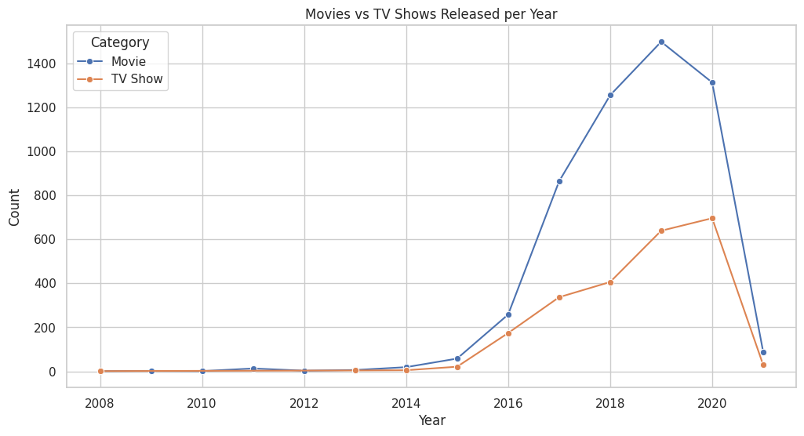
RESULTS1

Slide 7
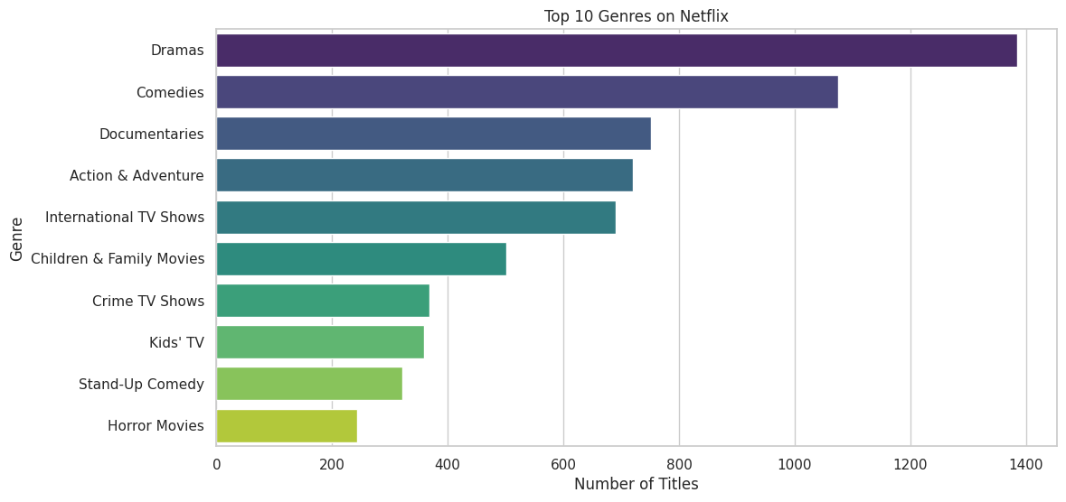
RESULTS2

Slide 8
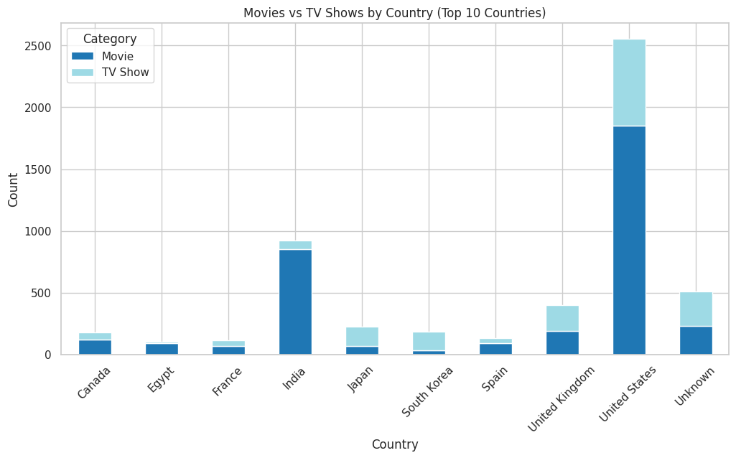
RESULTS3

Slide 9
GitHub repository
https://github.com/Kunsh1/VOIS_AICTE_Oct2025_MajorProject_KunshMIttal.git

Slide 10

Getting started with Linux File Certificate

Slide 11
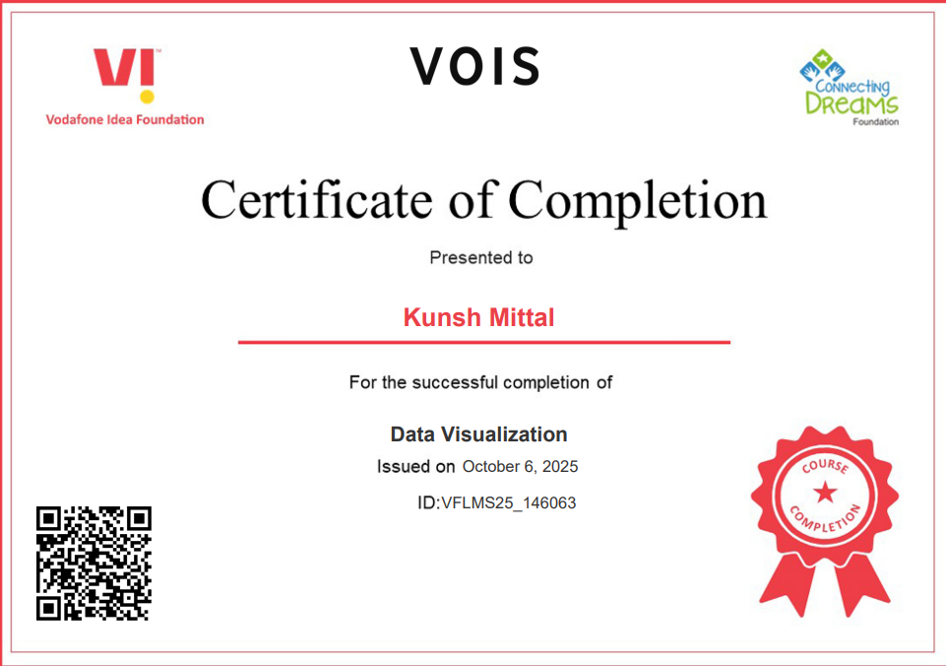
Data Visualization Certificate

Slide 12
Thank you
.
.

